Slide 1
Topic : - Ping Pong Game with user Login System
Java Programming Lab and Database Management System Miniproject.
Presented By -
Nikhil Namdev Chandekar - 2010048
Kunal Rajendra Angal - 2010051
Bhavesh Gajanan Raut - 2010047
Omkar Gajanan Vasudev - 2010067
Darshan Santosh Aivale - 2010058
Under the Guidance :-
Prof. Ashwini Patil
Prof. Priyanka Jadhav

Slide 2
Index :
Introduction
Aim and Objective
Scope of the project.
Flow-chart of system
Process Model.
Database Requirement of system
Classes and Packages used in Project
Data Flow Diagram
E-R diagram of database
Attributes of database
Project Snapshots.
Future scope
Conclusion
Reference

Slide 3
This is a simple game developed in java with Source Code. Front-end interface is designed using java . In our free its very efficient to play such a game .
This is a two-player game in which players need to touch the ball with the paddle if the ball will not touch the paddle then the other player will get numbers and vice versa.
Before playing this game User or player must login with username and password.
For to become authorized user or player, Register with your Information and Login again.
Two players should log in into the game to play.
Introduction

Slide 4
To create user friendly game with authorized users.
To create simple User login and register system for players.
To store the history of game along with winner and score.
Aim and Objective of the Project

Slide 5
Scope of the Project :-
Pong is a 2D video game inspired from the sport table tennis Features a very basic graphical user interface
A ball is passed between two paddles controlled by the two players .​
A player can invoke only two actions move the paddle upwards move the paddle downwards .​
While entering into game 2 players should log in and need to enter the score To win.
After completion of game, System will store the history. And any user is able to to see past history.

Slide 6
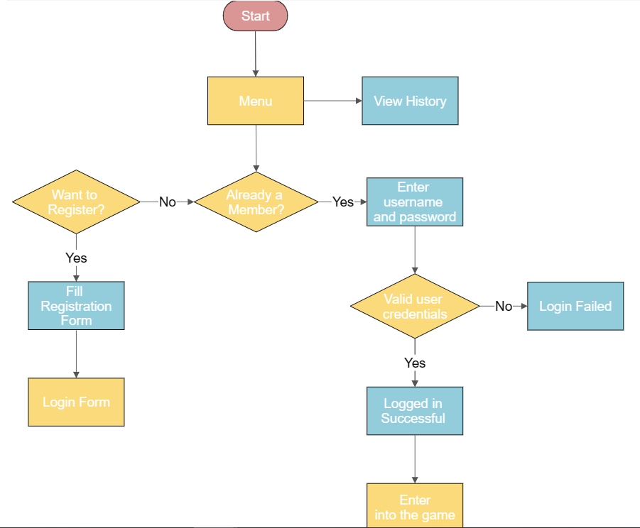
Let’s have look on Flow Diagram...

Slide 7
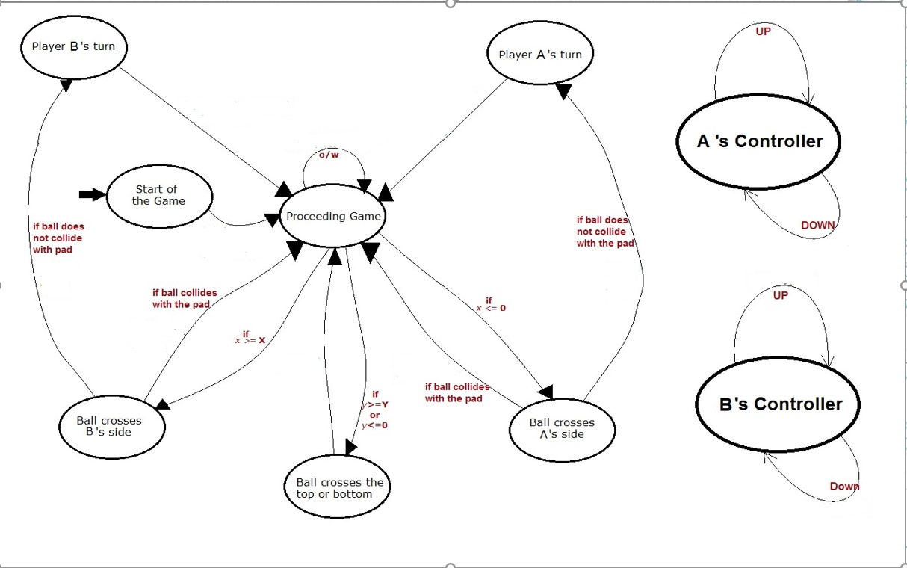
Process Model

Slide 8
Database Requirements of the system
Xampp (Latest version).
MySql connector JAR file – for databse connectivity
Commands used for queries :
Data Manipulation Languge
Data Definition Languge
Select insert,
Delete
Alter Truncate
Rename Create.

Slide 9
Swing Classes used in Project
Swing Classes
JLabel and JPanel
JTextField
JPasswordField and TextField
JProgessbar
JTable
JButton

Slide 10
Classes and interfaces used : -
Action Listener
Key Bindings
Thread
Rectangle class
Graphics
AudioInputStream
Clip
Image
ImageIcon

Slide 11
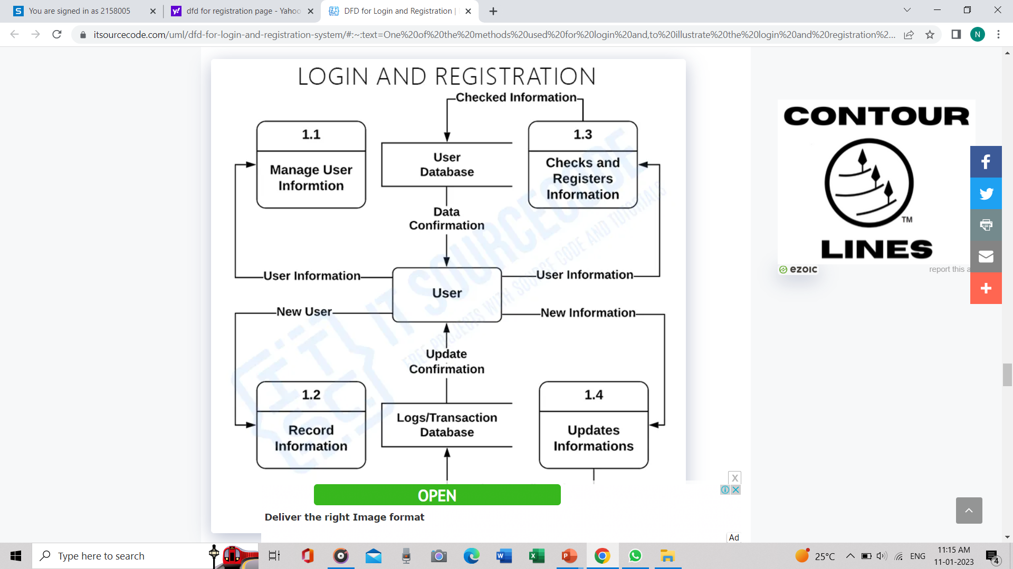
Data Flow diagram

Slide 12
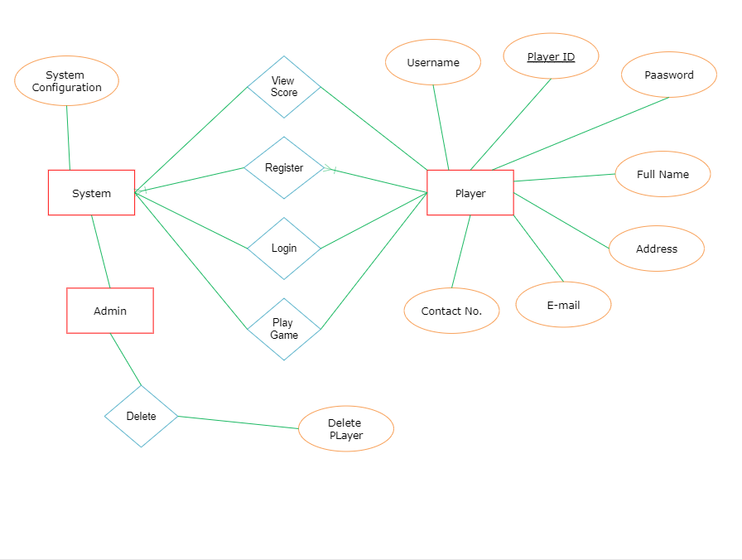
Entity Relationship Diagram…

Slide 13
Tables and Attributes in System : -
Table Name | Attribute | Description
Register | User Id | User can register his user ID
 | User Name | User can register his user name
 | Password | User can register his password
 | Full Name | User can register his user full name
 | Address | User can register his user address
 | E-mail | User can register his mail
 | Contact Number | User can register his contact number
 | Confirm Password | User can confirm his pasword
Table Name | Attribute | Description
Show history | Player 1 | Name of player 1
 | Player 2 | Name of player 2
 | Score to win | Score of winner
 | Winner | Name of winner

Slide 14
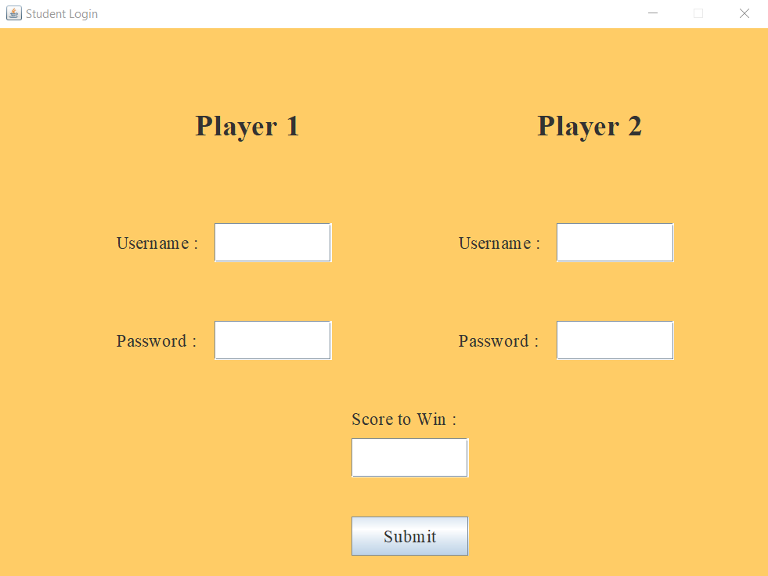
Login Page….
Two players will Login to the game with their username and password
Players will set score to win also.

Slide 15
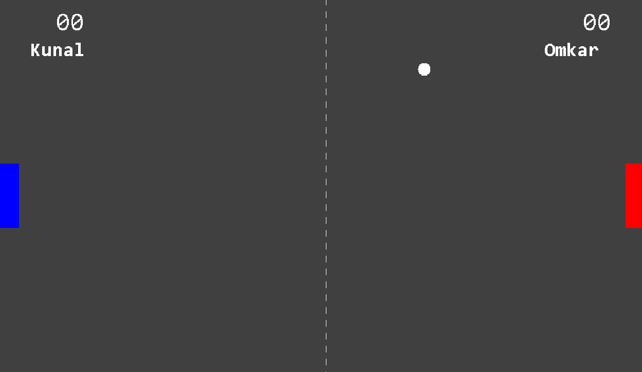
Game Panel along with Score Coverage…

Slide 16

Winner Dialog -
“WinnerDialog will display winner at the end of game…and data will be inserted into history table along with player names, score and Winner…”

Slide 17
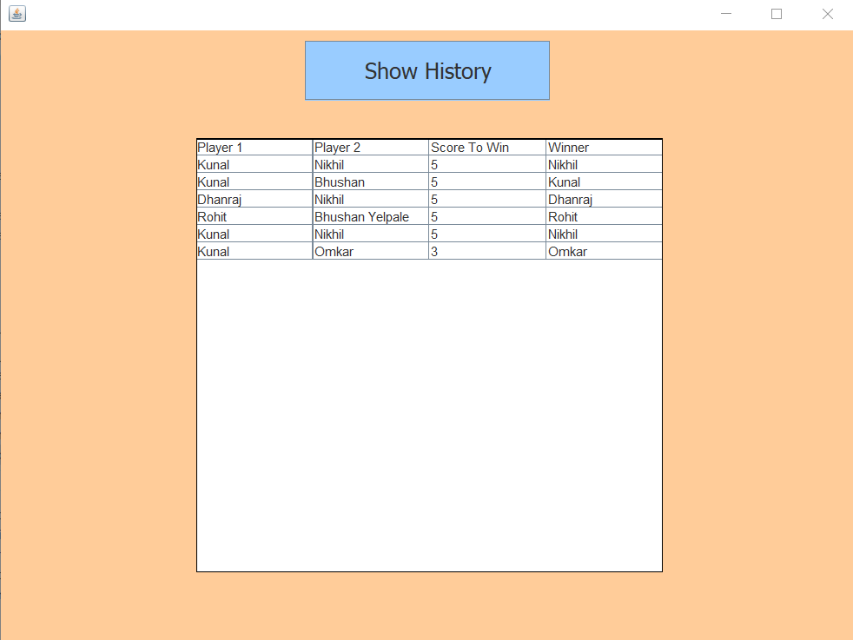
History Page –
Any user can view history of the game.
History contains usernames of both the players, score and winner among them.

Slide 18
Future Scope : -
Creating a game is great chance for programmers to create more interesting games.
This Game project is simple one, and it gives new Ideas and methods for creating new Games.
To give authorization for players is one of the emerging concept in Gaming world which requires database management.
To display History of game is user demand in which we can see history anytime.

Slide 19
We successfully completed the prescribed project in Java programming language with database connection.
According to commands given in sql blocks all commands reflected their results in database.
Game gives smoth experience for players. It is user friendly and simple game.
Anyone can play this game by using desktop and keyboards keys.
Conclusion

Slide 20
References
Java Swing GUI - https://www.youtube.com/watch?v=Kmgo00avvEw&t=12640s
Java Database Connectivity - https://www.youtube.com/watch?v=AHFBPxWebFQ
StackOverflow – Resolving Doubts
W3School.com
GeeksForGeeks.com

Slide 21
THANKS!
Any questions?

